Slide 1
Chapter 7
Introduction to Router Configuration

Slide 2
Outline
  7.1 Introduction
  7.2 Router Fundamentals
  7.3 The Console Port Connection
  7.4 The Router’s User EXEC Mode
  (Router>)
  7.5 The Router’s Privileged EXEC Mode
  (Router#)

Slide 3
Outline
  7.1 Introduction
  7.2 Router Fundamentals
  7.3 The Console Port Connection
  7.4 The Router’s User EXEC Mode
  (Router>)
  7.5 The Router’s Privileged EXEC Mode
  (Router#)

Slide 4
Outline
  7.1 Introduction
  7.2 Router Fundamentals
  7.3 The Console Port Connection
  7.4 The Router’s User EXEC Mode
  (Router>)
  7.5 The Router’s Privileged EXEC Mode
  (Router#)

Slide 5
Outline
  7.1 Introduction
  7.2 Router Fundamentals
  7.3 The Console Port Connection
  7.4 The Router’s User EXEC Mode
  (Router>)
  7.5 The Router’s Privileged EXEC Mode
  (Router#)

Slide 6
Outline
  7.1 Introduction
  7.2 Router Fundamentals
  7.3 The Console Port Connection
  7.4 The Router’s User EXEC Mode
  (Router>)
  7.5 The Router’s Privileged EXEC Mode
  (Router#)

Slide 7
Outline
  7.1 Introduction
  7.2 Router Fundamentals
  7.3 The Console Port Connection
  7.4 The Router’s User EXEC Mode
  (Router>)
  7.5 The Router’s Privileged EXEC Mode
  (Router#)

Slide 8
Objectives
Describe the purpose of a router
Describe the purpose of a gateway
Describe the steps (software and hardware) for connecting to a router’s console port
Describe the Cisco IOS command structure
Define the function of the Cisco command line interface

Slide 9
Objectives
Define the functional difference with the router’s privilege and user modes
Be able to enter basic router configuration modes
Demonstrate that you can enable and disable certain router interfaces

Slide 10
Objectives
Describe what information is contained in the running-configuration file
Define what it means for an interface to be administratively up or down.

Slide 11
Introduction
The main objective of this chapter is to introduce the use of the Cisco IOS (Internet Operating System) software for configuring routers.
Cisco IOS is the operating software used to configure all Cisco routers. Cisco IOS includes a command line interface (CLI) for inputting instructions to configure the Cisco router interface.

Slide 12
Certifications
Cisco certifications such as the CCNA Cisco Certified Network Associate
the CCNP Cisco Certified Network Professional, and the professional benchmark for internetworking expertise
the CCIE – Cisco Certified Internet Expert base their testing on the applicant’s ability to configure, troubleshoot, and analyze LANs that incorporate the use of Cisco router’s.

Slide 13
Chapter 7-2
Router Fundamentals

Slide 14
Introduction
This section further defines the function of a router in a network and describes how data packets travel through a layer 3 network.
A layer 3 network uses IP addressing for routing data packets to the final destination.
Delivery of the data packets over the layer 3 network is made possible by the use of a destination MAC address, IP address, network addresses, and routing tables.
Each of these concepts are examined in this section.

Slide 15
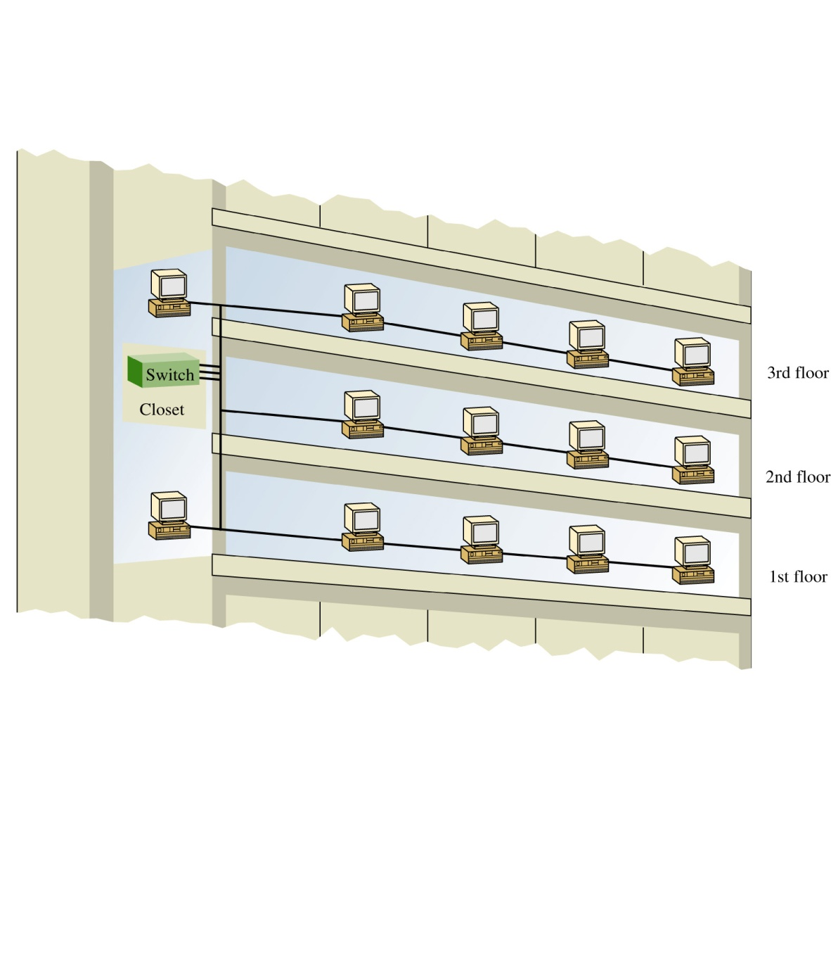
LANs sizes are not necessarily restricted in size. A LAN can have 20, 200 computers or even more. There can also be multiple LANs interconnected that essentially create one large LAN.
For example, the first floor of a building could be set-up as one LAN, the second floor a LAN, and the third floor another. The three LANs in the building can be interconnected into essentially one large LAN using switches and the switches interconnected as show.

Slide 16
Is it bad to interconnect
LANs this way?
As long as switches are being used to interconnect the computers, the impact of the interconnected LANs has minimal impact on network performance.
This is true as long as there are not to many computers in the LAN. The number of computers in the LAN is an issue because layer 2 switches do not separate broadcast domains.

Slide 17
Broadcast Domains
This means that any broadcast sent out on the network (e.g. the broadcast associated with an ARP request) will be sent to all computers in the LAN.
Excessive broadcasts are a problem because each computer must process the broadcast to determine if it needs to respond and this takes computer processing time.
This essentially slows down the computer and the network.

Slide 18
Flat Network
A network with multiple LANs interconnected together at the layer 2 level is called a flat network. A flat network is where the LANs share the same broadcast domain.
The use of a flat network should be avoided if possible for the simple reason that the network response time is greatly affected.
Flat networks can be avoided by the use of layer 3 networks. This is the next topic.

Slide 19
Layer 3 Networks
In a simple office type LAN introduced in Chapter 1 and the building LAN just discussed, the hosts are interconnected with a hub or switch. This allows data to be exchanged within the LAN however data cannot be routed to other networks.
Also, the broadcast domain of one LAN is not isolated from another LAN’s broadcast domain. The solution for breaking up the broadcast domains and to provide network routing is to incorporate routing hardware into the network design to create a routed network. A routed network uses layer 3 addressing for selecting routes to forward data packets. A better name for a routed network is a layer 3 network.

Slide 20
Layer 3 Networks
In layer 3 networks, routers and layer 3 switches are used to interconnect the networks and LANs
This isolates broadcast domains
Enables hosts from different LANs and networks to exchange data.
Data packet delivery is achieved by handing off the data to adjacent routers until the data reaches its final destination. This typically incorporates the passing of data packets through many routers and many networks.

Slide 21
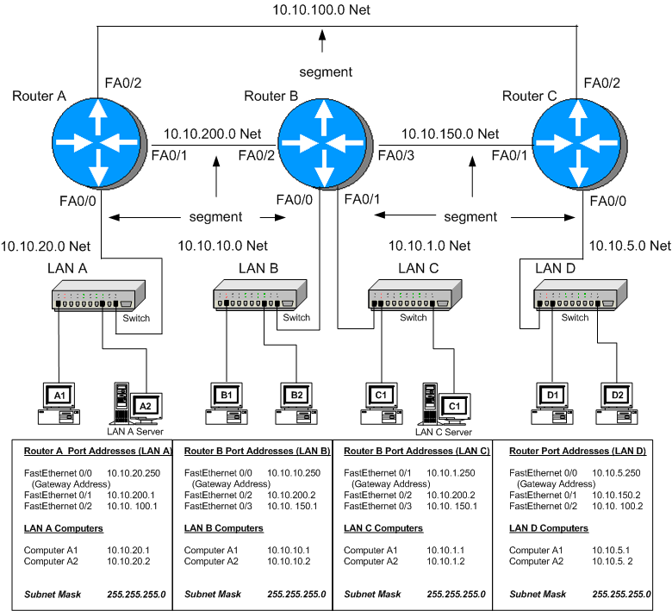

Slide 22
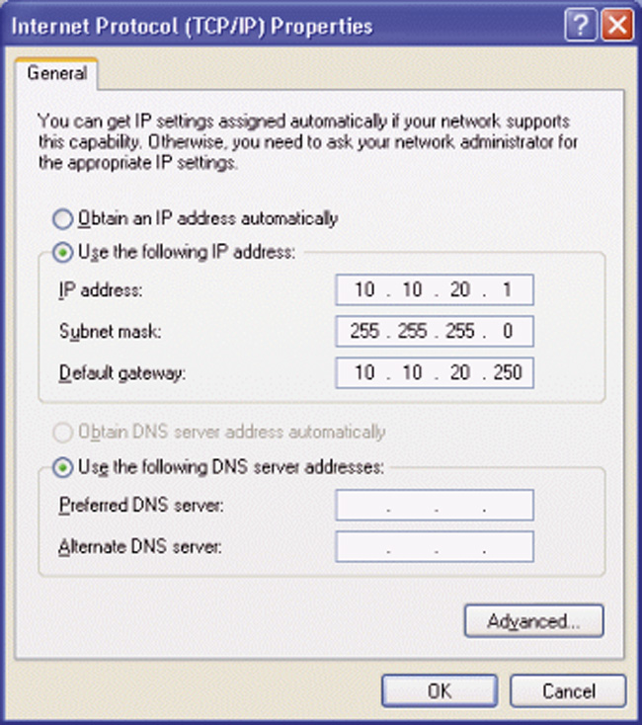
The default gateway address is the IP address of a networking device (e.g. router) used to forward data that needs to exit the LAN.
An example of a setting a computer’s default gateway is provided. The default gateway address for computer A is 10.10.20.250.
This is the IP address of RouterA’s FastEthernet 0/0 port. Fig. 6-2 shows that RouterA’s FA0/0 port connects directly to the switch in LAN A.

Slide 24
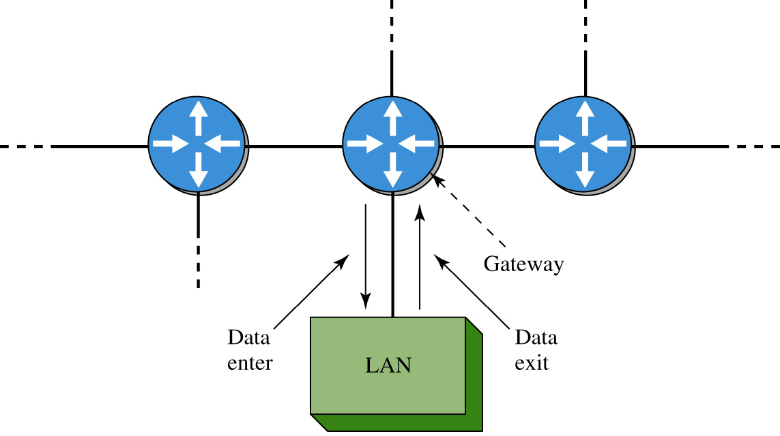
The term gateway is a term used to describe the networking device that enables data to enter and exit a LAN. The gateway is where the host computers forward data packets that need to exit the LAN.

Slide 25
In most networks, the gateway is typically a router or switch port address. An example of a gateway is provided in the block diagram shown. The block shows that data enters and exit the LAN via the gateway.

Slide 26
Example 7-1
Problem:
A computer host sends two data packets out on the network. Each data packet has a different IP destination addresses. Determine if the data packets are to be forwarded to the default gateway or should remain in the same LAN as the host.
The source host IP address is 10.10.20.2, and a subnet mask of 255.255.255.0 is being used. The destination IP address for the data packets are 10.10.1.1 and 10.0.20.3.
Pause the player, solve the problem, then start the player to check your answer.

Slide 27
Example 7-1
Solution:
First determine the network or subnet where the source host resides. This can be determined by “ANDing” the subnet mask with the source host IP address as shown.
Remember, the subnet masking is a binary “AND” operation.
source IP address: 10. 10. 20. 2
subnet mask 255. 255. 255. 0
______________
10. 10. 20. 0
Therefore the source host is in the 10.10.20.0 subnet

Slide 28
Example 7-1
Determine the destination network for the data
packet given the following information:
a destination IP address: 10. 10. 1. 1
subnet mask 255.255.255. 0 _____________
subnet 10. 10. 1. 0
Answer: The destination subnet address for part (a) is 10.10.1.0. This not in the same subnet as the 10.10.20.2 host (10.10.20.0 NET), therefore the data packet is forwarded to the default gateway.

Slide 29
Example 7-1
(b) Determine the destination network for a data packet
given the following information:
destination IP address: 10. 10. 20. 3
subnet mask 255. 255. 255. 0
_____________
subnet 10. 10. 20. 0
Answer: The destination subnet for part (b) is 10.10.20.0 which is the same subnet as the host therefore the data packet remains in the 10.10.20.0 subnet.

Slide 30
next hop address
The IP address of the data packet sent from the source computer to the gateway, is examined by the router and a next hop address is selected.
The gateway examines the destination IP address of all data packets arriving at its interface. The router uses a routing table to determine a network data path and the next hop address.
A routing table is a list of the possible networks that can be used to route the data packets.

Slide 31
Alternate Data Paths
Alternate data paths are usually provided so that a new route can be selected and data delivery maintained even if a network route is down.
The next hop address is the IP address of the next networking device that can be used to forward the data packet to the destination.

Slide 33
MAC Addresses
The MAC addresses are used to define the hardware address of the next hop in the network.
The term next hop refers to the next networking device that is being used to relay the data packet to either an intermediate hop or possibly to the final destination.
Once the next hop is defined, the MAC address of the next hop is determined and the data packet is relayed.
Once the routes are fully configured, data packets can be exchanged between any LANs in the interconnected routed network.

Slide 35
segment
A segment in a network defines the physical link between two internetworking devices (e.g. router-hub, router-switch and a router-router).
For example, in an interconnected network, a segment is the name of the link between a router and another router.
Another example is the segment that connects a router to a LAN via a hub or a switch. Each network segment has its own network address.

Slide 36
In an interconnected network, a segment is the name of the link between a router and another router.

Slide 37
In an interconnected network, a segment is the name of the link between a router and another router.

Slide 38
In an interconnected network, a segment is the name of the link between a router and another router.

Slide 39
In an interconnected network, a segment is the name of the link between a router and another router.

Slide 40
Another example is the segment that connects a router to a LAN via a hub or a switch. Each network segment has its own network address.

Slide 41
Another example is the segment that connects a router to a LAN via a hub or a switch. Each network segment has its own network address.

Slide 42
For the small campus network shown, the network IP address for the segment connecting LAN A to the router is 10.10.20.0. All hosts connected to this segment must contain a 10.10.20.#. For example, Computer A1 is assigned the IP address 10.10.20.1.

Slide 43
subnet
The segment is sometimes called the subnet or NET. These terms are associated with a network segment address such as 10.10.20.0.
In this case, the network is called the 10.10.20.0 NET. All hosts in the 10.10.20.0 NET will have a 10.10.20.# IP address.

Slide 44
The network addresses are used when configuring the routers and defining what networks are connected to the router.
For example 10.10.20.0, 10.10.200.0, 10.10.100.0

Slide 45
Physical Layer Interface
The physical layer interface on the router provides a way to connect the router to other networking devices on the network.
For example, the Ethernet ports on the router are used to connect to other Ethernet ports on other routers.
Fast Ethernet and Gigabit Ethernet ports are available on routers to connect to other high speed Ethernet ports.

Slide 46
Physical Layer Interface
Routers also contain serial interfaces that are used to interconnect the router and the network to other serial communication devices.
For example, connection to Wide Area Networks requires the use of a serial interface to connect to a communications carrier such as Sprint, MCI, AT&T, etc.
The data speeds for the serial communication ports on routers are typically much slower than that data speeds available on Ethernet, FastEthernet, and Gigabit Ethernet. The range of the data speeds for the serial ports on the router are selectable from 2500 bps to 4 Mbps and even higher data rates.
Note: There are high speed serial communication links available for router connections to to/from ISPs. This is discussed in Chapter 8.

Slide 47
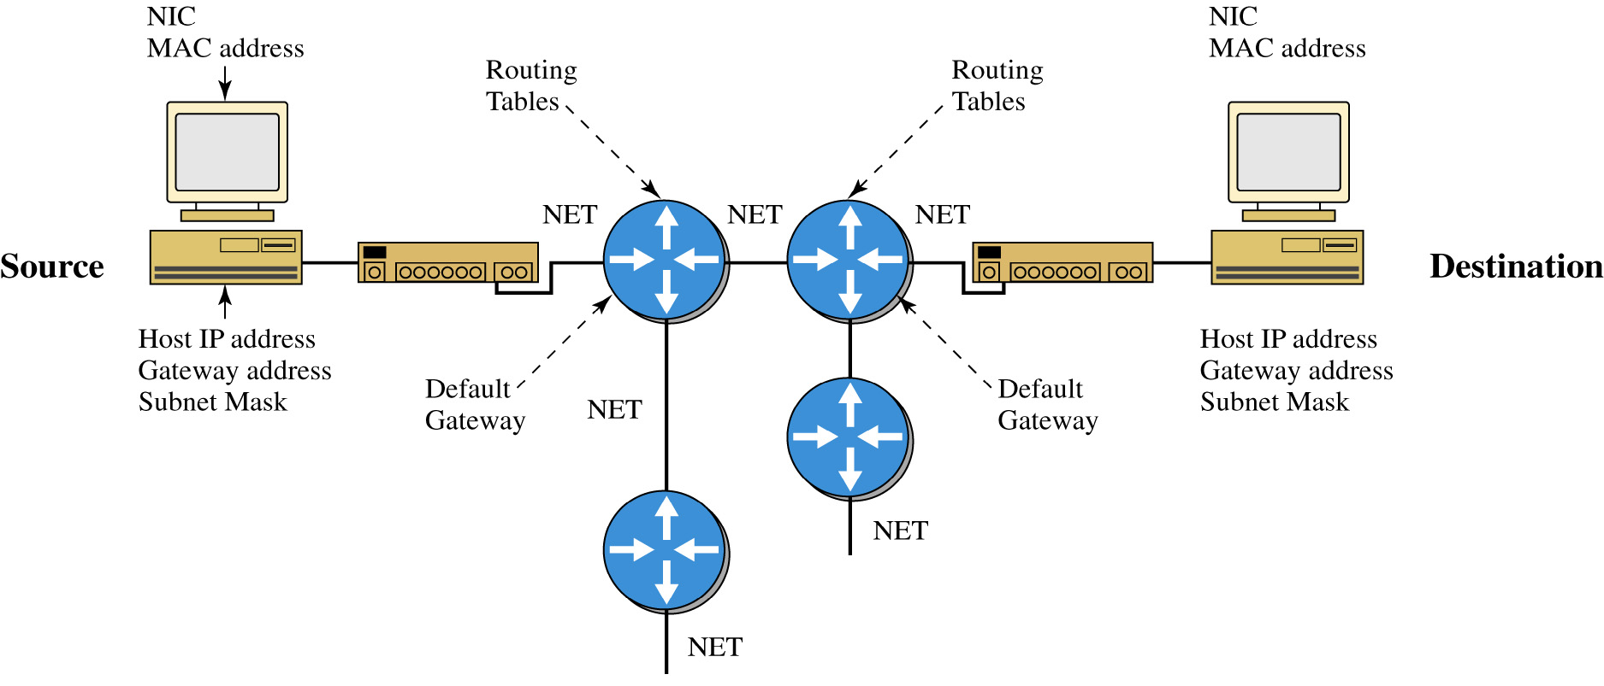
The figure shown is an example of a layer 3 network. The components that make up the layer 3 network are shown. The source host computer has an installed network interface card (NIC), an assigned IP address and subnet mask. The subnet mask is used to determine if the data is to stay in the LAN or is to be forwarded to the default gateway provided by the router. The router uses its subnet mask to determine the destination network address. The destination network address is checked with the router’s routing table to select the best route to the destination.

Slide 48
The data is then forwarded to the next router, the next router determines the destination network address, checks it routing table and forwards the data to the next hop. If the destination network is directly connected to the router then the router issues an ARP request to determine the MAC address of the destination host. Final delivery is then accomplished by forwarding the data using the destination host computer’s MAC address. Routing of the data through the networks is at layer 3 and the final delivery of data in the network is at layer 2.

Slide 49
Section 7-2 Key Terms
Broadcast Domain
Flat Network
Routed Network
Layer 3 Network
Default Gateway Address
Next Hop Address
Subnet, NET

Slide 50
Chapter 7-3
The Console Port Connection

Slide 51
The Console Port
The router’s console port is used as the initial interface for configuring the router. It is a slow speed serial communications link and it is the only way to communicate with the router until the router interfaces have been configured.
Specifically, the console connections is an
RS-232 serial communications port that uses an RJ-45 jack to connect to its interface.

Slide 52
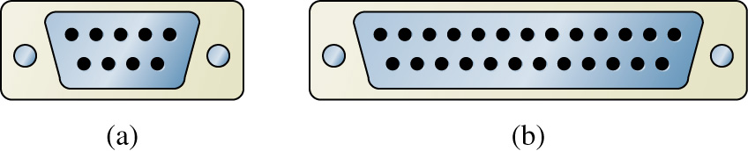
DB-9
DB-25
The RS-232 protocol running on the console port is the same communications protocol format used on a computer’s (COM1, COM2) port, however, the connector for the serial communications port on the computer is either a DB-9 or DB-25 type connector. The DB-25 serial connection is seldom used.

Slide 53
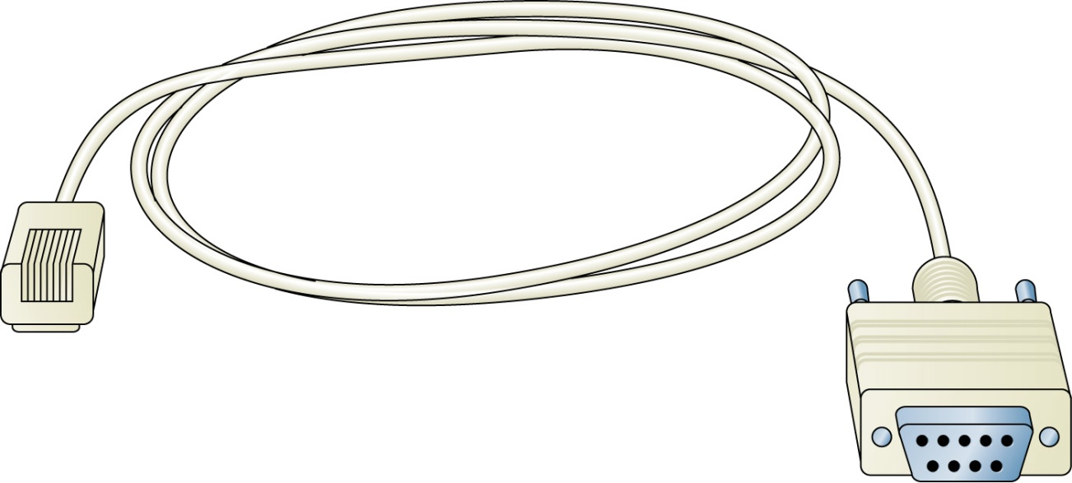
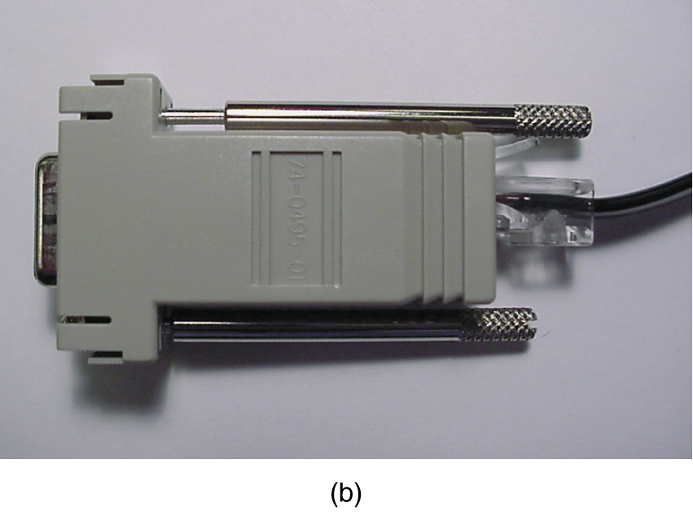
FIGURE 7-7 (a) A console cable with an integrated DB-9 connector; (b) a console cable using an RJ-45 rollover cable and a DB-9 to an RJ-45 adapter.
(a)

Slide 54
Connecting the Console Cable
Connect the DB-9 end of the console cable to any of the available serial ports (COM1, COM2, etc.) on the computer. The router’s console input uses an RJ-45 jack and the console cable must have an RJ-45 plug.
The cable used to connect to the RJ-45 jack to the computer is called a rollover cable. A rollover cable is a flat cable that reverses signals on each cable end. For example, pins 1–8, 2-7, 3-6 and so on.

Slide 55
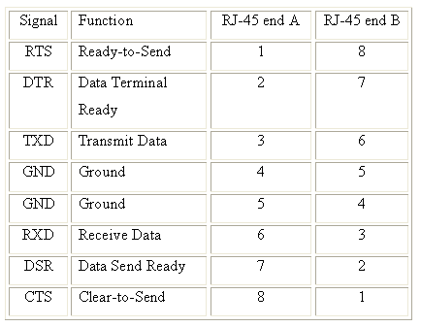
Rollover Cable

Slide 56
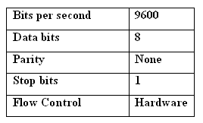
Hyperterminal
A serial communications software package such as Microsoft’s Hyperterminal can be used for establishing the communications link to the router’s console input. The settings for the serial interface on Cisco’s console port are provided.

Slide 57
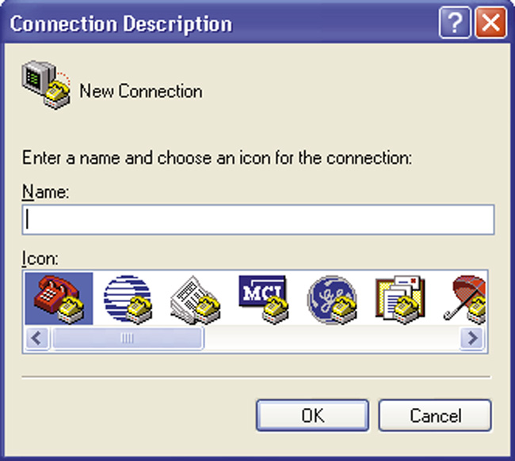
Enter a name for your connection such as CiscoRouter and select an icon to be associated with the connection. Click OK when done.

Slide 58
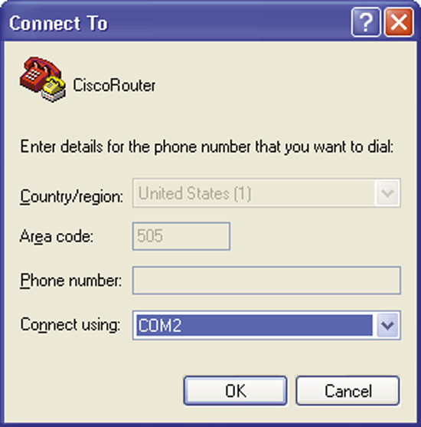
The Connect To menu lets you specify how you are making the serial connection to the router.
This example is showing the connection is configured to use the computer’s COM2 serial port.
Change the Connect using parameter to match the connection (COM1, COM2, …) you have made on your computer.

Slide 59
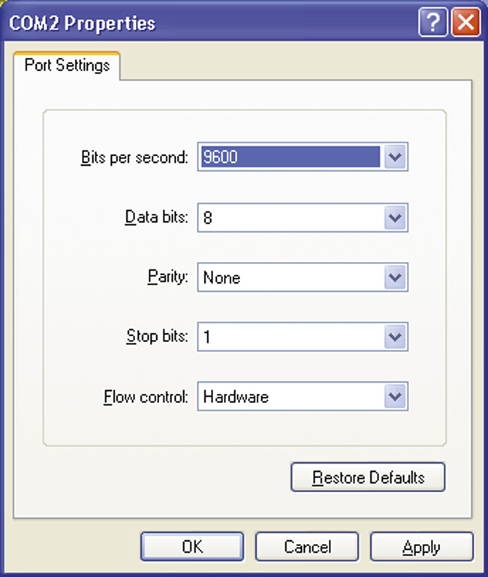
The next menu is the properties menu for your serial connection. This menu is labeled COM2 Properties since the Connect using COM2 parameter was specified in the previous menu.
The COM2 properties will have to be set to match these settings. The COM2 Properties menu with the settings entered is shown

Slide 60
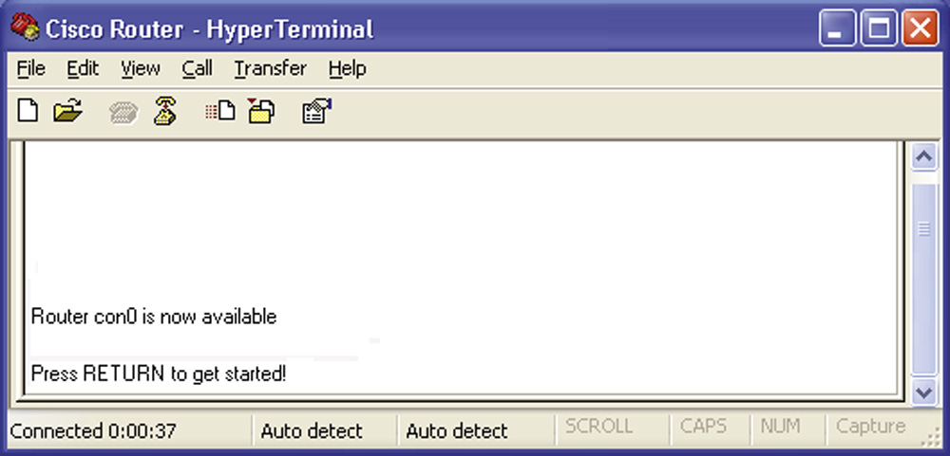
You should see the image shown when a connection has been established. If the text does not display “Press RETURN to get started” then press enter to see if the router resets itself. Another possible screen you might see may only have the Router> prompt. Press enter and if the Router> remains then you are connected. If this doesn’t correct the displayed text the router may need to be restarted.

Slide 61
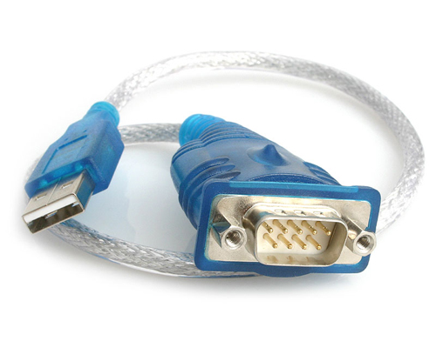
Console Connection - MAC
The following are the steps for establishing a console port via the USB serial connection on the MAC computer. This requires the following:
a serial communication software such as ZTerm. ZTerm is a shareware program for the MAC that can be downloaded from the Internet.
You will also need a USB to a 9-pin
RS232 male serial adapter. Such as
the USB to 9-pin adapter cable
shown.

Slide 62
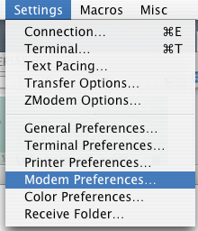
Console Connection - MAC
Install the serial communications software and the driver. Start the serial communications software. Click on Setting – Modem Preferences. This opens the window shown.
You will need to change the serial port so that it is set to usbserial0 and Click OK when the change to usbserial0 has been made. Next, click on Settings – Connection. This opens the menu shown in Fig. 6-14. The following settings need to be set for the serial console connection. Click OK when done.
Data Rate: 9600 Data Bits: 8
Parity: N Stop Bits: 1
Hardware Handshake

Slide 63
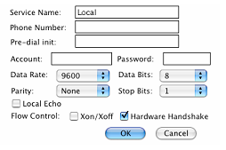
Console Connection - MAC
You will need to change the serial port so that it is set to usbserial0 and Click OK when the change to usbserial0 has been made. Next, click on Settings – Connection. This opens the menu shown.
Data Rate: 9600
Data Bits: 8
Parity: N
Stop Bits: 1
Hardware Handshake

Slide 64
Section 7-3 Key Terms
RS-232
DB-9
DB-25
Console Cable
COM1, COM2, …
Rollover Cable

Slide 65
Chapter 7-4
The Router’s User EXEC Mode (Router>)

Slide 66
Introduction
This section introduces the use of the Cisco Internetwork Operating System (Cisco IOS) used for configuring Cisco routers.
Cisco IOS is the standard interface software available on all Cisco routers. The software is regularly updated providing improved configuration, management and monitoring capabilities.

Slide 67
Cisco IOS
The Cisco IOS structure is fairly easy to navigate once you learn a few basic commands.
Cisco IOS uses a command line interface (CLI) for inputting commands when configuring Cisco routers.
Some simple concepts such as how to access the help menu, using the show commands and configuration options are explained.

Slide 68
Router Demonstration

Slide 69
Section 7-4 Key Terms
Hostname
User EXEC Mode
User Mode
?
show flash
show version
Router uptime

Slide 70
Chapter 7-5
The Router’s Privileged EXEC Mode (Router#)

Slide 71
Introduction
Configuring a router interface requires that the privileged mode be entered on the router.
The privileged mode allows full access for configuring the router interfaces and configuring routing protocol.
This chapter focuses on general configuration steps for the router and configuring the router’s interfaces, both Ethernet and serial.

Slide 72
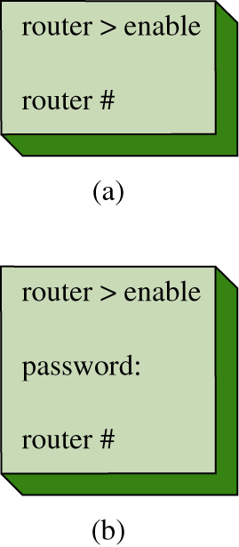
Privileged Mode (Router #)
The privileged mode is entered using the command enable at the Router> prompt as shown. The # sign after the router name indicates you are in the privileged mode (e.g. Router#).
Use caution once you have entered the privileged mode in a router. It is easy to make mistakes and incorrectly entered router configurations will affect your network.

Slide 73
Configuration Mode
The next commands examined require that the router’s terminal configuration mode be entered. To do this, enter the command configure terminal (abbreviated conf t) at the RouterA# prompt to enter the router’s configuration mode.
RouterA#conf t
Enter configuration commands, one per line. End with CNTL/Z.
RouterA(config)#
Or
RouterA#configure terminal
Enter configuration commands, one per line. End with CNTL/Z.
RouterA(config)#

Slide 74
Password Protection
Password protection for the privileged (enable) mode is configured by setting the enable secret. The steps are as follows. Enter the router’s configure terminal mode by entering configure terminal or conf t at the Router# prompt. Enter the command enable secret [your-password] <enter>. An example is shown.
Router# conf t
Router(config)#
Router(config)# enable secret my-secret
This sets the password for entering the router’s privileged mode to my-secret. The password for entering the router’s privileged mode must now be entered to gain access to the router’s privileged mode.

Slide 75
Setting the Line Console Password
The router has three line connections that can be used by a user to gain access to the router. The line connections available on a router can be displayed using the line ? command at the Router(config)# prompt. The available line connections typically are:
aux Auxiliary line (modem back-up)
console Primary terminal line (console port)
vty Virtual terminal
(for a telnet connection)
The console (primary terminal line) is the console port and vty is the virtual terminal used for telnet connections. The following steps demonstrate how to configure password protection for the console port and the virtual terminal.

Slide 76
Passwords
Router(config)# line console 0
Router(config-line)# login
Router(config-line)# password [my-secret2]
Router(config)# line vty 0 4
Router(config-line)#login
Router(config-line)# password [my-secret3]

Slide 77
FastEthernet Interface Configuration
Router(config)# int fa0/0 (interface FastEthernet slot/port)
Router(config-if)# ip address 10.10.20.250 255.255.255.0
Router(config-if)#no shut
2w0d: %LINEPROTO-5-UPDOWN: Line protocol on Interface FastEthernet0/0, changed state to up

Slide 78
Checking the interface configuration status
Router# sh ip int brief
Interface IP-Address OK? Method Status Protocol
FastEthernet0/0 10.10.20.250 YES manual up up
FastEthernet0/1 10.10.200.1 YES manual up up
FastEthernet0/2 10.10.100.1 YES manual up up

Slide 79
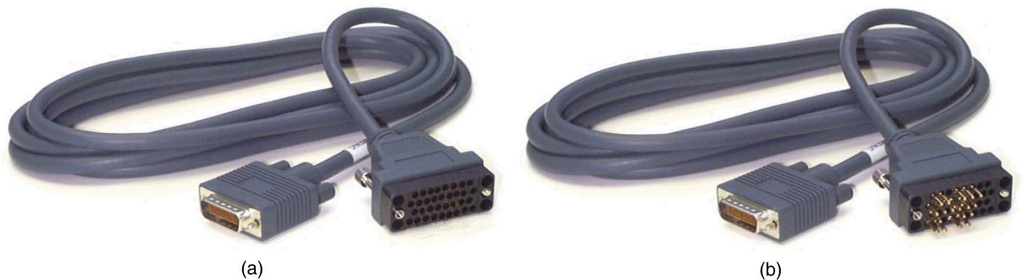
Configuring the Serial Interface
Configuring the serial port requires that the following questions be answered:
What is the IP address of the interface?
What is the subnet mask for the interface?
What interfaces are responsible for providing clocking?

Slide 80
Configuring the Serial Interface
Router(config)# int s0/0 (interface serial slot/port)
Router(config-if)# ip address 10.10.50.30 255.255.255.0
Router(config-if)# sh controllers serial 0/0
HD unit 0, idb = 0xCF958, driver structure at 0xD4DC8
buffer size 1524 HD unit 0, V.35 DCE cable
cpb = 0x21, eda = 0x4940, cda = 0x4800
.
RouterA#sh controllers serial 0/1
HD unit 1, idb = 0xD9050, driver structure at 0xDE4C0
buffer size 1524 HD unit 1, V.35 DTE cable
cpb = 0x22, eda = 0x30A0, cda = 0x30B4

Slide 81
Configuring the Serial Interface
Router(config-if)# clock rate 56000
Router(config-if)# no shut
2w0d: %LINK-3-UPDOWN: Interface Serial0, changed state to up
2w0d: %LINEPROTO-5-UPDOWN: Line protocol on Interface Serial0/0, changed state to up

Slide 82
Checking the configuration
Router# sh ip int brief
Interface IP-Address OK? Method Status Protocol
FastEthernet0/0 10.10.20.250 YES manual up up
FastEthernet0/1 10.10.200.1 YES manual up up
FastEthernet0/2 10.10.100.1 YES manual up up
Serial0/0 10.10.128.1 YES manual up up
Serial1/0 10.10.64.1 YES manual up up

Slide 83
Section 7-5 Key Terms
Privileged Mode
enable
Router#
configure terminal (conf t)
Router(config)#
Router(config-line)#
Router(config-if)#

Slide 84
Section 7-5 Key Terms
no shutdown (no shut)
show ip interface brief (sh ip int brief)
DCE
DTE

Slide 85
Chapter 7
Summary

Slide 86
Summary
This chapter has presented an overview of the router, a technique for establishing a console port connection, and the basic steps for configuring the router’s interface. The student should understand the difference in the router’s user and privileged EXEC modes. A list of the router prompts encountered in this chapter are provided.
The router prompts and their definition.
Router>User EXEC mode
Router#Privileged EXEC mode
Router(config)#Configuration mode
Router(config-if)#Interface configuration mode
Router(config-line)#Line terminal configuration mode prompt

